Slide 2
ADO.NET Entity Framework 5 for Real Web Applications
Adam Tuliper
Software Architect
Cegedim

Slide 3
PLEASE READ (hidden slide)
This template is designed for use with Office PowerPoint 2007 and 2010. The charts and graphics can be edited with PowerPoint 2007 and 2010, but not with PowerPoint 2003.
This template uses Microsoft Segoe UI, a standard font that is included in Office 2007, Office 2010, Windows Vista and Windows 7.

Slide 4
Notes (hidden)
Some speakers at Microsoft like to use this slide for hidden “notes slides”.
Delete it if you don’t want to use it.
NEXT: <next slide title>

Slide 5
Deadlines & Resources
Thank you for taking part in TechEd North America 2012. Below is a list of key dates and resources:
Important Content Deadlines – detailed instructions are found on the Speaker Portal at https://northamerica.msteched.com/signin:
May 1 at Noon: Upload a DRAFT of your PPT for subject-matter expert (SME) review.
May 1 to May 25: CONTENT REVIEW (track specific instructions are found on the speaker portal)
June 5 at 5 pm PT: Upload FINAL PPT presentation on the Speaker Portal. Continue to rehearse your spoken presentation but do not make any more edits to the deck. The uploaded version will be used for your presentation.
YOUR PROMPT FINAL PPT SUBMISSION IS APPRECIATED.
No design support will be offered onsite.
Slide Design Resources – Located on the Speaker Portal (graphics, webinar, etc.)
If you include any third-party photography or art, licensing information and permission must be credited in the PPT or it will be deleted.
Points of Contact
Direct presentation questions to tespkr@microsoft.com
Direct content questions to your Track PM
PRINTING: This template is intentionally set to print in color or grayscale, not black and white
Notes:
© 2010 Microsoft Corporation. All rights reserved. Microsoft, Windows, Windows Vista and other product names are or may be registered trademarks and/or trademarks in the U.S. and/or other countries.
The information herein is for informational purposes only and represents the current view of Microsoft Corporation as of the date of this presentation. Because Microsoft must respond to changing market conditions, it should not be interpreted to be a commitment on the part of Microsoft, and Microsoft cannot guarantee the accuracy of any information provided after the date of this presentation. MICROSOFT MAKES NO WARRANTIES, EXPRESS, IMPLIED OR STATUTORY, AS TO THE INFORMATION IN THIS PRESENTATION.

Slide 6
Scrub Checklist
Upload your final deck on the speaker portal on or before June 5, 2012 at 5 pm PT.
PowerPoint presentations undergo a brief scrub process and are posted to CommNet for attendee access at least 48 hours prior to the session. No design support will be available onsite.
The Scrub Process will include:
Verification that required slides are included
Remove any non-template logos and graphics from the walk-in slide
Remove all comments, hidden slides and speaker notes from slides
Set file properties box
Reset printability to grayscale
Notify Presentation Manager of any images identified as unlicensed for escalation
Rename files to match naming convention
Correct session title and session code to match printed Mini Guide and Schedule Builder
Speakers, you must:
Use the provided event template and associated colors, fonts, layout and transition slides
Correct product names to follow applicable branding rules

Slide 7
PowerPoint Guidelines
Font, size, and color for text have been formatted for you in the Slide Master
This template uses Segoe UI a standard font included in Office 2007, Office 2010, Windows Vista and Windows 7
Use the color palette shown below
Sample Fill
Sample Fill
Sample Fill
Sample Fill
Sample Fill
Sample Fill
Sample Fill
Sample Fill

Slide 8


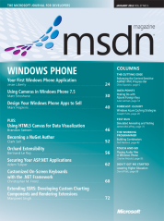
About Me
Adam Tuliper
Twitter: @AdamTuliper
CompleteDevelopment.blogspot.com
pluralsight.com author
MSDN Security Topics - December, January
Questions, Comments, Amazon Gift Cards,Beer, etc
adam.tuliper@gmail.com
The code is on github under adamtuliper

Slide 9


Slide 10
Why Entity Framework?
FAST Setup – Data code written for you
No manual managing of
Keys, Relationships (Order.Customer = customer)
Eager/lazy loading
Validation
Smart updates only for changed columns
No changes to object = No update to the database
All Major RDMS supported
No SQL Injection!!
Easy API (DbContext), Code First, and Enum support
Notes:
3:45

Slide 11
What’s a ‘Real’ Web App?
Samples inadequate for ‘organized’ N-Tier apps
Beyond prototype or uber-basic CRUD
An app you don’t want all code in one project
An app that clearly has separate layers
Apps with Complex logic/views
An app that could benefit from Dependency Injection (See blog for complete usage with EF)

Slide 12
Everything you need
Install Entity Framework
Install-Package EntityFramework
EF Power Tools, SQL Compact Toolbox (opt)
Create your projects in layers
Web
Domain– Entities and Repository Interfaces
DataAccess (Contains repository implementation and Context)
Test Project
Design/Create Entities
Add Validation
Handle concurrency
Use Repository Pattern for ALL CRUD operations
Notes:
7:45
Use the universal provider or:
http://stackoverflow.com/questions/7575439/getting-own-ef-4-1-code-first-classes-to-work-with-net-membership
Go into your C:\Windows\Microsoft.NET\Framework\v2.xx or v4.xx\ and execute aspnet_regsql, this will launch a wizard that allows you to choose your database and it will add the stored procs and tables to allow membership to function.
Then you run the ASP.NET configuration wizard (the little toolbox icon at the top of your solution explorer) and then configure your roles and accounts. See this page and skip to the Configuring the website for membership and roles section.

Slide 13
Understanding EF Three important items
Context
The spork of Connection, Command, Transaction
Handles all CRUD to database
Parties after midnight cause honey badger don’t care
POCO
Entity States
Query easily via: context.Entry(customer).State
Added, Detached, Unchanged, Modified
Notes:
Done at 28:00
Context (DbContext/ObjectContext)
Connection, Command, Transaction all in one
Handles all persistence calls to the database
All operations must go through context
Change tracking is done by the context
Remember to Dispose
The Context is not thread safe
New per request, do not cache, do not use a static instance
MS recommends DbContext

Slide 14
It’s all about the context
Little Nancy was in the garden filling in a hole when her neighbor peered over the fence. Interested in what the little girl was up to, he politely asked, “What are you up to there, Nancy?”
“My goldfish died,” replied Nancy tearfully, without looking up, “and I’ve just buried him.”
The neighbor was concerned, “That’s an awfully big hole for a goldfish, isn’t it?”
Nancy patted down the last heap of earth and then replied, “That’s because he’s inside your stupid cat.”
:\

Slide 15
Background - POCOs
Isn’t it just a DTO?
100% Persistent Ignorant
 | POCO | DTO
Can contain business logic | X
Should not reference framework implementations (ex. EF libraries) | X | X
Designed to transfer between layers |  | X
Knows nothing of persistence | X | X
Transfers State |  | X
Notes:
Done at 35
EF mapping classes are the way to go instead of EF specific data annotations to remain ‘pure’ since they can change the behavior in relation to EF specific code.
The validation data annotations are ok as they do not effect this.

Slide 16
Model First/Database First
Pros
Visual Designer -> Architectural documentation
Easy code regeneration with model or db changes
Very fast implementation
Cons
May not prefer to deal with XML based EDMX file
Some may feel loss of control without ‘pure’ code
Please use: ADO.NET DbContext Generator T4 Templates
Notes:
First Demo, new project, add model, add dbcontext.

Slide 17
Code First
Pros
POCO by default – simple!
Can specify initializers to create database
Fluent API or clean attributes for validation
Cons
No Visual Designer
No direct stored procedure support for operations.
Easily can call Context.Database.SqlQuery(..) in repository though
Requires only model(s) and a context class.
Can reverse engineer an existing database
Notes:
Done at ~ 23
---Demo the reverse engineer
--demo unit testCode first will create the db locally if it doesn’t exist.. Requires sql express, sql ce for sdf
--DB changes must be added in code (if required) – This can also be a plus since someone else’s changes on a limited entity we use won’t break our entity.
Code first WILL overwrite any existing classes with NO WARNING!!
In generating a test database, it will create an EDM table to store schema info. If the schema changes you can specify to recreate the db if the model changes.
Note that when you reverse engineer all of the properties are added in a Map class. Ex.
Relationships are defined in the map class to:
// Relationships
this.HasOptional(t => t.Customer)
.WithMany(t => t.Orders)
.HasForeignKey(d => d.CustomerId);
To map to the table name:
modelBuilder.Entity<class>().MapSingleType().ToTable("someTable")
To customize the column mapping
modelBuilder.Entity<class>().MapSingleType( customer => new
{
UNIQUEID = customer.CustomerId,
SomeOtherOldColumn = customer.NewColumnName,
..
..
}
).ToTable("someTable");
Note we can also use the attributes on the model.
Key StringLength ConcurrencyCheck Required Timestamp DataMember RelatedTo MaxLength StoreGenerated
Demo reverse engineering a code first model into a project.
Generate classes
MVC Context if you don’t want to manually create one.
- Manually generate context or right click Add Controller and it will generate a context class for you.
ObjectSet<Customer> bip = context.Customers
DbSet now?
I thought we just had a List<Customer> before?
We want Persistent Ignorant classes. Our context handles the CRUD operations. So
Context is like an entity connection/data adapter/command all in one.
If you have a reference to EntityFramework.dll in your web project, your layers are crossing. Remove it. Do you still compile?

Slide 18
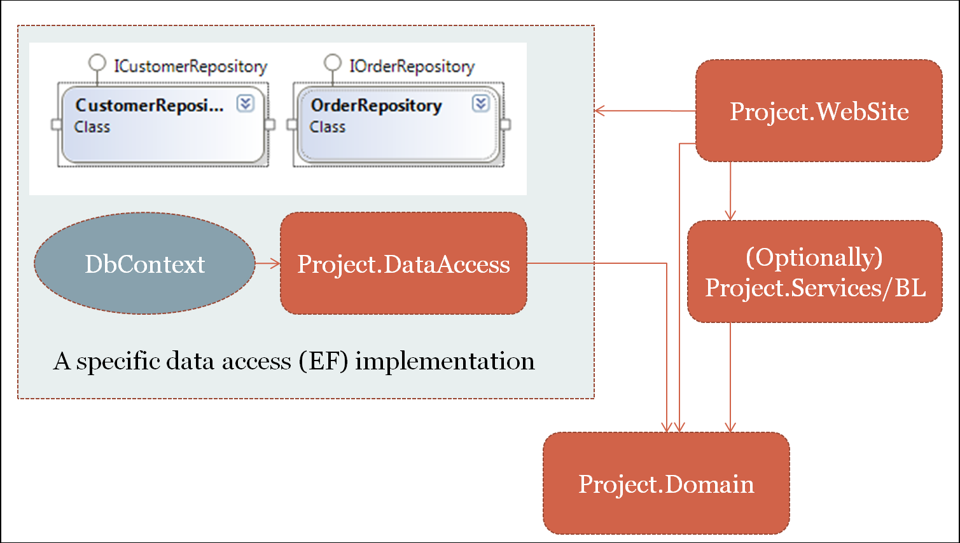
Basic Architecture
Notes:
Orange are projects
Explain repository pattern.
Domain contains entities. They are business related.
DataAccess contains context, its data related.
Repository is defined as “an abstraction that provides us with persistence ignorance and a separation of concerns where the responsibility of persisting domain objects is encapsulated by the Repository that leaving the domain objects to deal entirely with the domain model and domain logic.
Your business objects (Customer, for ex) contain NO persistence logic!

Slide 19
Reposi-what?
Repository is defined as “an abstraction that provides us with persistence ignorance and a separation of concerns where the responsibility of persisting domain objects is encapsulated by the Repository thus leaving the domain objects to deal entirely with the domain model and domain logic.

Slide 20
‘Real’ Web Considerations
Use the Repository Pattern!
Swappable (think Azure)
Single point of change (to/from stored proc)
Convert all collections to IEnumerable first
Avoid deferred execution outside of context scope:
var customer = ctx.Customers;
var customer = ctx.Customers.ToList();
New context per each request - Do not cache.
Use Universal Membership provider
Supports SQL Server, SQLCE, SQL Express, SQL Azure
Install-Package MiniProfiler.EF
Notes:
Check out test: TestEnumerableOutsideContext
Pause on repository pattern and talk about it. Explain how the context is used and disposed after EVERY request.
Then do a demo for Ienumerable on the codefirst stuff.
Discuss that we want a mew context per request.

Slide 21
MVC Considerations
For Views, don’t use EF entities, map to ViewModels
Automapper is your friend http://automapper.org/
ViewModel + AutoMapper maps entities for GET only
DbContext is not thread safe.
Instantiate a new one per request in constructor or via DI
Do not cache it or use a static instance.
Dispose Context when done (DI helps)
Do not throw all EF code into controller
MVC Controller and code behinds should be THIN & Organized!
Greatly helps testing
Notes:
Done 49
http://localhost:38842/Customer
Show index, mapping via lambda, repository.
Show automap attribute
Don’t let entities leak out onto the page.
Edit a customer, notice get vs postback
Explain what a ViewModel is and why you don’t want entities showing up.
Show the Index method manual viewmodel mappings.
Then show the edit method and how we use the AutoMap attribute.
Explain how all db code is not in the presentation layer, a controller is an orchestrator for the UI.

Slide 22
Web Forms Considerations
Can ‘magically’ use EntityDataSource/ObjectDataSource
I recommend handling context lifetime yourself
Data binding must occur in the context scope unless ToArray/ToList()
Do not add entities to ViewState
ASP.NET 4.5 now has strongly typed controls
Can easily use ViewModels and AutoMapper
Notes:
Done 51 min
EntityDemoSite.WebformsAspNet45, Default.aspx
Demo in context and out of context
http://localhost:64097/DataBindList.aspx
http://localhost:64097/Customers.aspx leave out a field so the validators fire.
http://localhost:64097/CustomerAdd.aspx demo data source designer.
Show: CheckForEfExceptions
Add demo for mapping objectcontext to dbcontext (or vice versa) for the EntityDataSource.
-if using objectdatasource your context must be instantiated inside of the repository! No DI integration here.

Slide 23
Validations
All work in MVC or Web Forms for server side validation
Fluent API (Integrated in MVC4, not in MVC3)
Data Annotations
IValidateableObject
All triggered by context.SaveChanges()
EF throws DbEntityValidationException
Client side validation?
Must use data annotations for MVC
Web Forms 4.5 supports data annotations
Otherwise no tight integration
Notes:
8 min
Data annotations not directly integrated into web forms but will raise dbentityvalidtionexception, same as if MVC on entity but using viewmodels.
Create customer Ivalidateable interface.
Demo each in sample project
If using MVC, ModelState will catch Data annotations, IValidateableObject but not fluent (yet) mvc4 does handle these (Ive tested DbEnityExceptions mapping to ModelState errors which is ok, but had problems with timestamps)

Slide 24
Handling Concurrency
Automatic via [TimeStamp] attribute & rowversion type
Must catch DbUpdateConcurrencyException
In both MVC & Web Forms
MVC -manually include model’s hidden timestamp field
Html.HiddenFor(o=>o.TimeStamp)
Web Forms various methods
Store timestamp as hidden field on form
GridView: DataKeyNames="CustomerId,Timestamp"
Notes:
-Demo timestamp code.
-Demo two saves via: http://localhost:38365/Department
I wanted to add some more info on this, seems concurrency is handled in two separate ways (at least). One I believe is simply to add a timestamp column to your table and decorate its property with the [TimeStamp] attribute. EF will automatically then compare this value in it's where clause. The other case according to the Contoso example: "you would have to mark all non-primary-key properties in the entity for concurrency tracking by adding the ConcurrencyCheck attribute to them. That change would enable the Entity Framework to include all columns in the SQL WHERE clause of UPDATE statements." – Adam Tuliper Sep 25 '11 at 15:22

Slide 25
Automatic Data Migrations
Provides mechanism to migrate model changes to DB
Migrations are handled from the package manager
Enable-Migrations -EnableAutomaticMigrations
Update-Database
Can downgrade to a past migration and remove columns
Notes:
Add a new property to customer class
Run Enable-Migrations –EnableAutomaticMigrations
3. Update-Database - Script or Update-Database to do the changes.
Install-Package EntityFramework
Update-Database –Script
Update-Database –Force
Enable-Migrations
Install-Package Unity.MVC3
Enable-Migrations -EnableAutomaticMigrations
Install-Package MiniProfiler.EF

Slide 26
Thanks!!
http://completedevelopment.blogspot.com/2012/06/dependency-injection-with-entity.html
completedevelopment.blogspot.com/2012/06/unit-of-work-pattern-with-entity.html
www.asp.net/web-forms/tutorials/aspnet-45/getting-started-with-aspnet-45-web-forms/create_the_data_access_layer
CompleteDevelopment.blogspot.com
Twitter: @AdamTuliper
Questions, Comments, Gift Cards, Beer
adam.tuliper@gmail.com

Slide 27


Related Content
DEV 301 ASP.NET Roadmap: One ASP.NET – Web Forms, MVC, and Web API
DEV333 The Scaling Habits of Microsoft ASP.NET Applications
TLC - Developer Tools, Languages & Frameworks – Ask an expert!
70-516 Accessing Data with Microsoft .NET Framework 4

Slide 28
Track Resources
Required Slide
*delete this box when your slide is finalized
Track PMs will supply the content for this slide, which will be inserted during the final scrub.
Resource 1
Resource 2
Resource 3
Resource 4

Slide 29



Resources
Learning
Connect. Share. Discuss.
Microsoft Certification & Training Resources
http://northamerica.msteched.com
www.microsoft.com/learning
TechNet
Resources for IT Professionals
Resources for Developers
http://microsoft.com/technet
http://microsoft.com/msdn

Slide 30
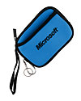

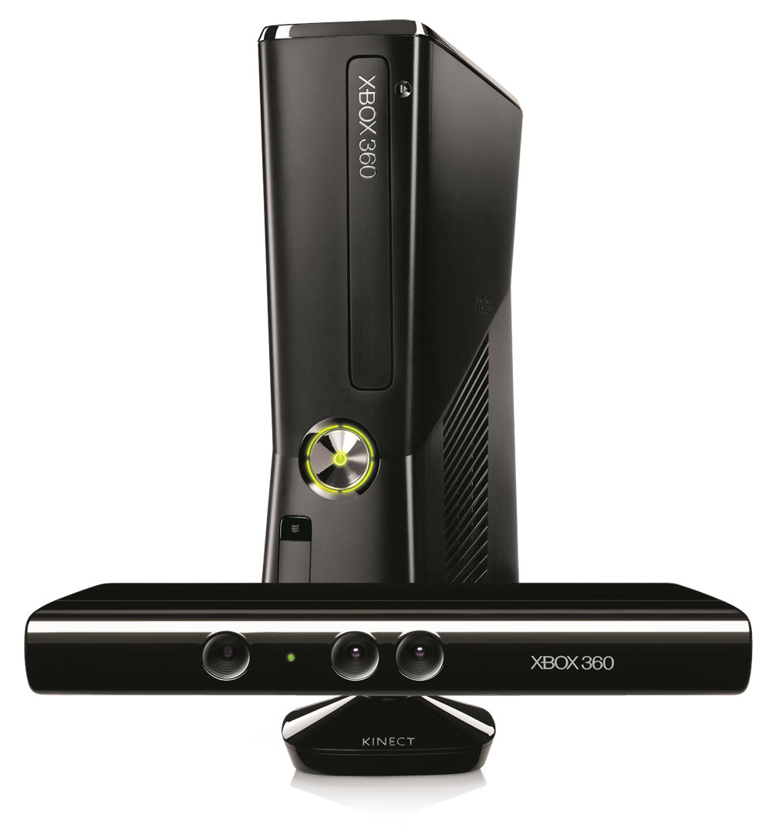




Required Slide
Complete an evaluation on CommNet and enter to win!

Slide 31

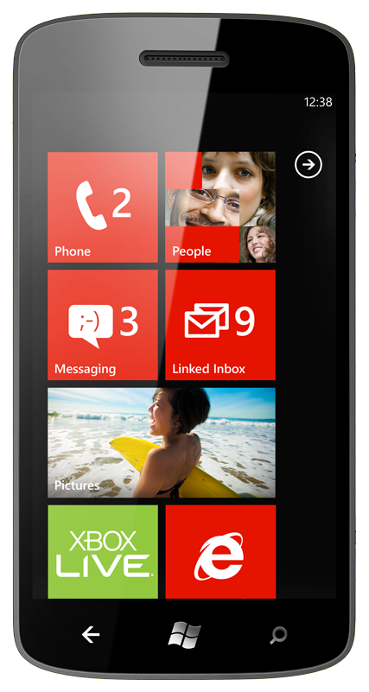
MS Tag
Required Slide
*delete this box when your slide is finalized
Your MS Tag will be inserted here during the final scrub.
Scan the Tag
to evaluate this
session now on
myTechEd Mobile
Notes:
TechEd is working with Microsoft Tag (http://tag.microsoft.com/overview.aspx) to create a unique Tag for every session at the event. Your session Tag will appear on both the room signage and at the end of your presentation. With your session Tag, attendees will be able to scan as they enter the room to retrieve session details, view speaker bios, and engage in discussions; or scan at the end of the presentation to evaluate your session and download materials.

Slide 32
© 2012 Microsoft Corporation. All rights reserved. Microsoft, Windows, Windows Vista and other product names are or may be registered trademarks and/or trademarks in the U.S. and/or other countries.
The information herein is for informational purposes only and represents the current view of Microsoft Corporation as of the date of this presentation. Because Microsoft must respond to changing market conditions, it should not be interpreted to be a commitment on the part of Microsoft, and Microsoft cannot guarantee the accuracy of any information provided after the date of this presentation. MICROSOFT MAKES NO WARRANTIES, EXPRESS, IMPLIED OR STATUTORY, AS TO THE INFORMATION IN THIS PRESENTATION.

